Slide 1

Intel Practicum - Project BOAT
Sponsor - Intel Point of contact - Jonathan Buhacoff, Eric Gee Faculty Advisor - Patrick Tague Team BlueChip - Deepti, Divya, Marcelo, Rashmi
INI Project Practicum, Fall 2014

Slide 2
Roadmap
Introduction - Problem statement
Background
System Solution - Architecture
Milestones
Exploration
Attestation plug-in
KMIP integration
Problems and solutions
Future work
Demo

Slide 3




Introduction - Problem statement
How to verify that the compute node is trusted?
Soln: Remote attestation.
How to ensure that none but the trusted compute node can view the VM?
Soln: Encryption.
How to manage/generate the secret keys used for encryption?
Soln: Barbican with KMIP server.
How to ensure none but client and agent (on behalf of the compute node) store and retrieve secret keys?
Soln: Authentication using SSL and authorization using Keystone.

Slide 4
Background
Remote attestation using Open Attestation.
Key management using Barbican.
Authorization using Keystone.

Slide 5
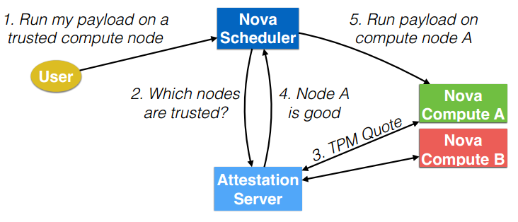
Remote Attestation
Prepare for Trust
Enable TXT & TPM
Populate whitelist
Establish Trust
TXT measures launch stack
Compare with states in TPM
Verify
Verify trust status (OpenStack scheduler -> OAT)
Establish trust with Trusted boot.
Launch MLE (Measured Launch Environment) on CN.
Intel VT-d (Virtualization Technology for Directed I/O) for MLE to protect itself.
Verify trust with Open Attestation.

Slide 6
Key Management - Barbican
Barbican - REST API which provides secure storage, provisioning and management of secrets.
It can handle many types of secrets, including:
Symmetric Keys
Asymmetric Keys
Raw secrets
Barbican fits into Intel’s Trusted VM solution model as a key management server which stores keys and provisions requesting cloud servers with keys based on their trust and policy compliance as attested by trust authority OAT.
Backend options Postgres (default), KMIP server or HSM.

Slide 7
Authorization - Keystone
Keystone is OpenStack’s identity service for authentication (authN) and authorization (authZ).
It achieves authZ by issuing authorization tokens to authenticated users.
Keystone uses a SQL backend for identity. This involves storing a user entry that contains a hash of the user’s password. When a user authenticates to Keystone to obtain a token, they provide their password, which Keystone hashes and compares with it’s stored copy.

Slide 8
Solution
In this project, we aim to develop an open source model that integrates:
Barbican (key management) + KMIP Server (key storage/retrieval)
Keystone (Authorization)
Intel-OpenStack trust attestation server OpenAttestation
for trusted computing on cloud infrastructure.

Slide 9

BOAT Architecture Overview
Client Side
CSP
Nova
Client
KMS
Keystone
Agent
Trusted CN
Untrusted CN
Barbican
Attest
Plugin
OAT Server
KMIP

Slide 10
BOAT Process - Key Generation
Client Side
Client
Client authenticates with keystone & requests for authZ token.
Client requests for symmetric key with some required specifications to Barbican server with authZ token.
Barbican validates token with Keystone.
Requests KMIP server to create key according to metadata specifications.
KMIP Server creates key and returns internal keyID to Barbican.
Barbican maps internal keyID to an external keyID and sends back KeyID to client.
1. Request & receive authZ token.
KMS
Keystone
7. Key ID
3. Check validity of token.
2. Order request for AES key with authZ token.
Barbican
Attest
Plugin
6.Generate KeyID
5. Internal keyID
4. Key request
KMIP
Notes:
Data flow here
Arrow text will be changed once the dataflow is added

Slide 11
BOAT Process - Key Retrieval (Client)
Client Side
Cinder
7. Encrypted VM, key ID
Client
6. Encrypted VM, keyID
Agent
KMS
Keystone
Client requests Barbican for key with KeyID.
Barbican checks authZ token validity.
Retrieves key from KMIP server.
Returns key to client.
Client encrypts VM with key and sends to Nova Scheduler.
5. Key
2. Check validity of token.
1. Key request of KeyID with authZ token.
Barbican
Attest
Plugin
4. Key
3.Request key
KMIP
Notes:
Data flow here
Arrow text will be changed once the dataflow is added

Slide 12
BOAT Process - Attestation + Key Retrieval (Agent)
Agent requests authZ token from Keystone
Agent sends KeyID, AIK of compute node and authZ token to Barbican
Barbican validates token with Keystone and retrieves key from KMIP Server
Before releasing the key, Barbican calls attestation plugin to check if compute node is trusted, which calls OAT.
OAT sends BindPubKey of trusted node to attest plugin
Barbican wraps the secret key with BindPubKey from plugin and sends to Agent
KMS
CSP
Keystone
1. Request & receive authZ token.
Agent
2. KeyID, AIK, token
Trusted CN
Untrusted CN
3. Validate token
12. Wrapped Key
Barbican
Attest
Plugin
6. Call attestation plugin
8. Request for measurements
9. Measurements
11. Wray key
7. Attestation Request, AIK
5. Key
4. Key request, KeyID
OAT Server
10. Trusted Flag, PubKey_{CN}
KMIP
Notes:
Data flow here
Arrow text will be changed once the dataflow is added

Slide 13
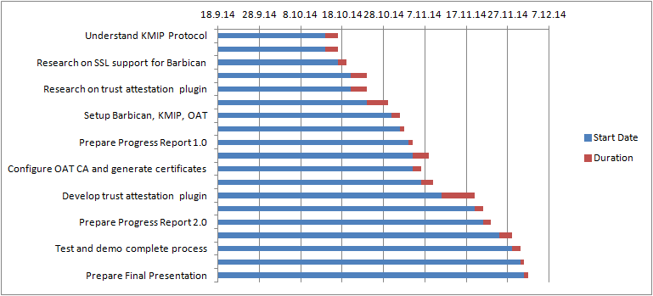
Milestones - Roadmap
Milestone 1: Exploration phase
Milestone 2: Plugin for Trust Attestation by OAT
Milestone 3: KMIP secret store integration

Slide 14
Milestone 1
Exploration Phase:
Get familiar with OpenStack architecture and terminology
Install and play with Barbican
Stevedore: Plugins written in python
Searching for KMIP open source
KMIP4J
Installed and run
Moved later to pydev for a natural integration with current plugin

Slide 15
Milestone 2 - Overview
KMS
CSP
Implemented the 3 A’s of security:
Remote attestation - Attest Plugin
Authentication - SSL for Barbican
Authentication + Authorization - Keystone with Barbican
Keystone
Agent
Trusted CN
Untrusted CN
Barbican
Attest
Plugin
OAT Server
KMIP

Slide 16
Milestone 2 - Attest Plugin
Attest Plugin intercepts Barbican communication with Agent to ensure that only trusted compute node receives the secret key.
Create external plugin for Barbican in stevedore and install package using setuptools in pyenv “barbican27” environment.
In barbican API, intercept GET request response with call to attest plugin, which requests trust assertion of AIK and BindPubKey of node from OAT.
Throw appropriate exception and close http connection if AIK is incorrect, if OAT server is unreachable or returns malformed BindPubKey, or if no BindPubKey is returned (indicating untrusted node)
For trusted node, wrap retrieved secret key with BindPubKey and return encrypted secret as response to agent.

Slide 17
Milestone 2 - Keystone with Barbican
Setup Keystone as a part of devstack on the same host as Barbican.
All requests to Barbican require an authorization token from Keystone.
Authorization tokens given based on username and password credentials.
Setup SSL with Keystone so that credentials & authorization token not sent in clear.

Slide 18
Milestone 2 - SSL for Barbican
Implemented SSL for Barbican using nginx server as front end.
Nginx performs mutual authentication using SSL certificates.
Forwards request to Barbican if it is able to authenticate the requester.
Barbican’s uwgsi doesn’t support SSL so nginx forwards the request without SSL
But this request is internal (to the same machine) which is why it is safe.

Slide 19
Milestone 3
KMS
CSP
Keystone
Agent
Trusted CN
Untrusted CN
Barbican
Attest
Plugin
OAT Server
KMIP

Slide 20
Milestone 3: Implementation Details
Define secret store implementations:
<barbican home>/setup.cfg
[entry_points]
barbican.secretstore.plugin =
store_crypto = barbican.plugin.kmip_secret_store:KMIPSecretStore
dogtag_crypto = barbican.plugin.dogtag:DogtagKRAPlugin
python file:class name
Install dependencies at barbican home folder:
pip install -e .

Slide 21
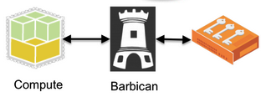
Milestone 3: Implementation Details
/etc/barbican/barbican-api.conf
# ================= Secret Store Plugin ===================
[secretstore]
namespace = barbican.secretstore.plugin
enabled_secretstore_plugins = store_crypto
Implementation for KMIP already exists in PyKMIP:
kmip_secret_store.py
store_secret
get_sectret
KMIP

Slide 22

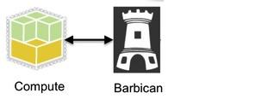

KMIP server
PyKMIP (used by kmip_secret_store.py)
Provide a sample KMIP server (server.py)
python server.py --host localhost --port 8443 --keyfile /home/dc/KMIPCredentials/private.key
--certfile /home/dc/KMIPCredentials/mycert.pem --ca_certs /home/dc/KMIPCredentials/ca.crt
CA

Slide 23
Milestone 3
KMIP4j:
Got rid of this plugin in this milestone.
Too much of a hassle to start db server and tomcat apache.
DB was ultimately not being used
Initially chose this because thought everything will work out of the box.
PyKMIP which is purely python works without causing any problems
Secret Generation
curl -X POST -H 'content-type:application/json' -H 'X-Project-Id: 12345' -H 'X-Auth-Token:<keystone token>' -d '{"type":"key", "meta": {"name": "<secret>", "algorithm": "aes", "bit_length": 256, "mode": "cbc", "payload_content_type": "application/octet-stream"}}' http://localhost:9311/v1/orders
Obtain a secret
curl -H 'Accept: text/plain' -H 'X-Project-Id: 12345' <secret_ref>

Slide 24
Problems faced and solutions
Time restriction (one month for working in the project)
Parallel task
Continuous work and team commitment
Github repository
Virtual machines
Google drive
Finding the right plugin format
Stevedore
Finding the right KMIP server that fits the OpenStack project
Barbican uwsgi doesn’t support SSL
Use front end server like nginx to provide SSL support
Buggy code - KMIP problems
PyKMIP
Lack of documentation in Openstack, KMIP4J for plugin configuration and kmip plug-in
Distribution lists

Slide 25
Future work
Stronger KMIP implementation
Integration with Intel solution and Openstack compute nodes
To have all components involved:
Nova
Agent
Trusted Compute Node
Untrusted Compute Node
Nova
Client
Agent
Trusted CN
Untrusted CN
Keystone
Barbican
OAT Server
KMIP

Slide 26

DEMO

Slide 27

Questions?

